Slide 1
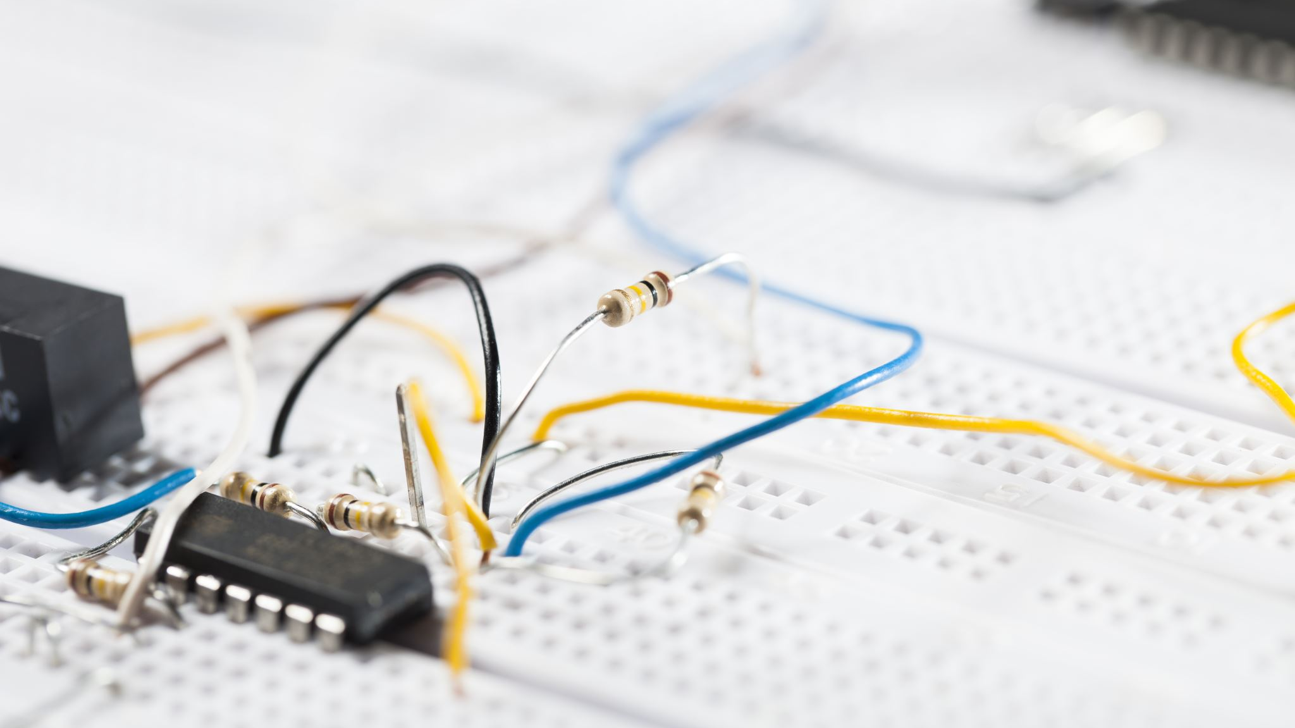
LPG Gas Sensor Interfacing with LPC2148
~A Suraj Reddy- AM.EN.U4CSE20012
A.S.K Viswas- AM.EN.U4CSE20013
N Sai Sandeep- AM.EN.U4CSE20049
P Laxmi Praneeth- AM.EN.U4CSE20052
CGS Pranav Advaith- AM.EN.U4CSE20056

Slide 2
INTRODUCTION
We have taken up LPG gas detection because the use case of LPG throughout the world is really high and the scope for the usage of other gases is limited. So, this module helps to detect if any LPG gas leakage takes place which eventually helps in preventing fire accidents caused due to LPG gas leakage.
The main constituents of LPG are propane and butane which is highly flammable chemical.
In order to monitor its presence sensing elements are deployed in its premises to detect the leakage and to avoid the accidents.

Slide 3
COMPONENTS REQUIRED
LPC2148 Development Board
GAS Sensor module
LCD Module

Slide 4
COMPONENT CONNECTION
IR Sensor
VCC- 5V
GND- Ground
DO- P1.24
LCD
RS-P0.8
RW- P0.9
EN- P0.10
Data Lines- P0.0 – P0.7

Slide 5
WORKING
Simply power the module with 5V and you should notice the power LED on the module to glow and when no gas is detected the output LED will remain turned off meaning the digital output pin will be 0V (LOW).
Now, introduce the sensor to the gas you want to detect and you should see the output LED to go HIGH along with the digital pin, if not use the potentiometer until the output gets high.
Now every time your sensor gets introduced to this gas at this particular concentration the digital pin will go high (5V) or else will remain low (0V).
Instead of LED we used LCD display where it displays Gas Detected when gas is actually detected or none.

Slide 6
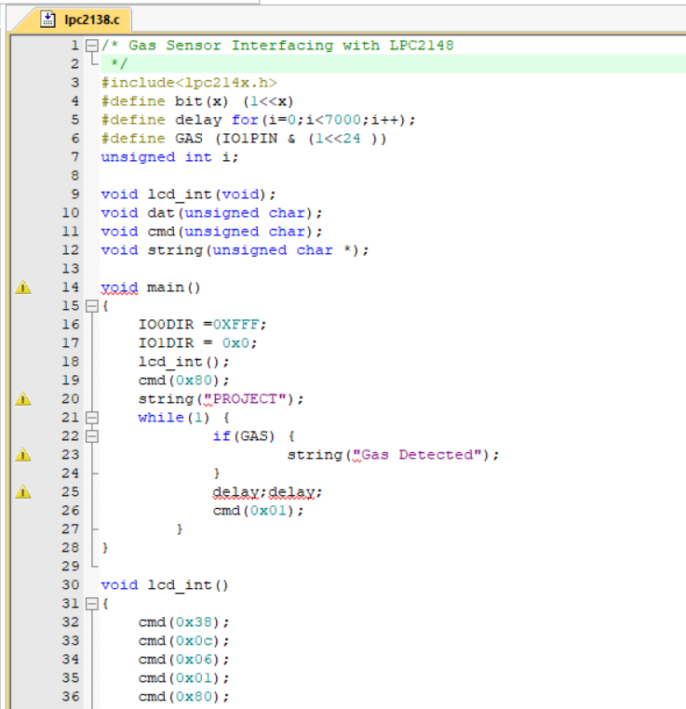
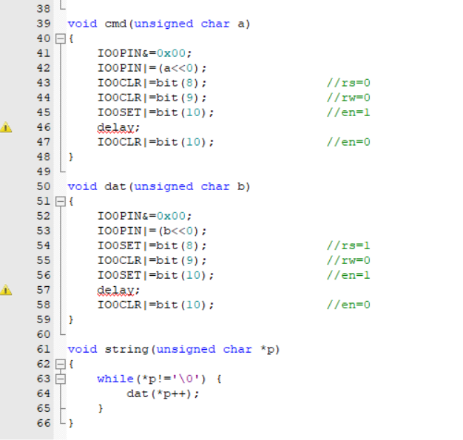
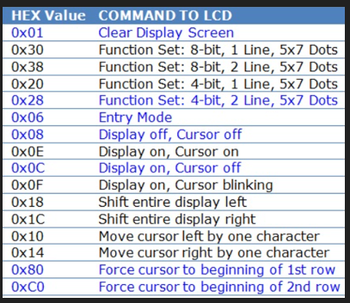
CODE
Rs=0 data treated as cmd or special instruction
Rs=1 data being sent is text and displayed on screen.
Rw=0 info on data bus is being written on lcd
Rw=1 program is reading the lcd.

Slide 7
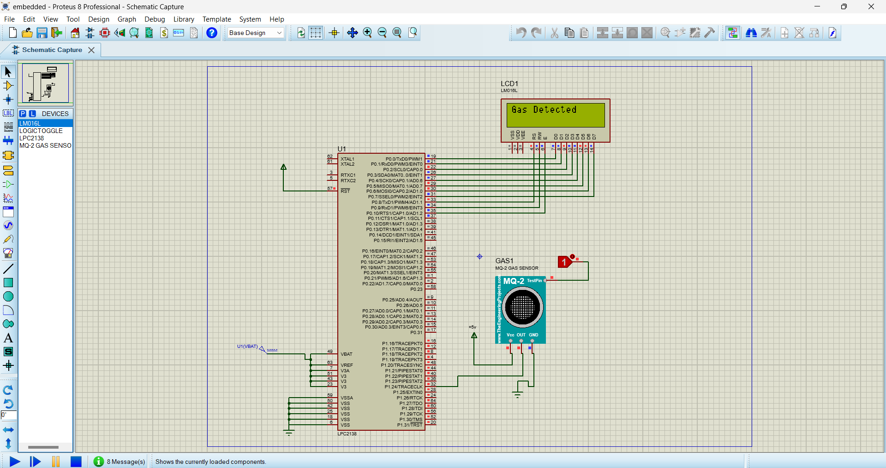
SIMULATION

Slide 8
APPLICATIONS
Detects or measures Gases like LPG, Alcohol, Propane, Hydrogen, CO, and even methane
Air quality monitor
Gas leak alarm
Safety standard maintenance
Maintaining environmental standards in hospitals

Slide 9
FUTURE SCOPE
In recent years due to explosion of LPG number of deaths has been increased. In this presentation, a method is proposed to implement a security system for detecting leakage of gas. This system detects and monitors the leakage of Liquid petroleum gas (LPG) using gas sensors and send signal to the microcontroller then microcontroller alerts the person about the gas leakage.
By this we can avoid such gas leakage accidents.

Slide 10


